Slide 1


Slide 2
Feed Your Inner Data Scientist
JavaScript tools for Data Visualization and Analysis

Slide 3
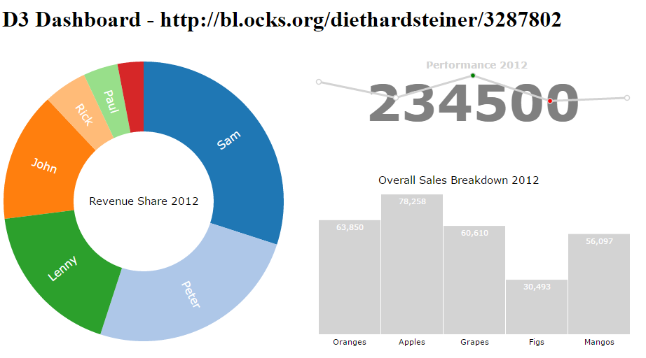
GOAL For Today
Big Data
Health
Gov’t
Financial
Dev Ops
IOT
Sensors
Stats

Slide 4
Bio
Doug Mair
Doug.Mair@gmail.com
@doug_mair
Director of Consulting for Improving Enterprises
Windows Developer User Group – Columbus, Ohio

Slide 5
Big Data
With IOT and business processes, lots of data is being collected
Exponential Growth – 2017 – 2.5 Giga-GB
Separation of concerns
Process the data on the Server as much as possible
Client computers should do as little work as possible.
Services and Event Queues are good Architectures to explore
Notes:
There are 2.5 quintillion bytes of data created each day at our current pace
That’s 18 Zeros – Billion GigaBytes –
Data Scientists spend most of there time cleaning / formatting data.
https://www.forbes.com/sites/bernardmarr/2018/05/21/how-much-data-do-we-create-every-day-the-mind-blowing-stats-everyone-should-read/#ecb94fa60ba9

Slide 6

Notes:
We can tell this is not random data There's a structure here What does this resemble? Brain? Universe? It's a treasure trove of info, but not discoverable or explorable.
How do we get meaning out of it?

Slide 7
Map / Reduce
MAP – Group, Sort and Filter.
Take all of the stock trades and split them out by company, date or time
Can be massively parallelized.
Reduce – Functions on each groups.
Examples are Counts, Sums and Averages.

Slide 8



Notes:
Often the data we have in Raw form is useless to our users We have to coalesce and massage the data to get at what is vital This is where the secret sauce and IP of companies is built

Slide 9
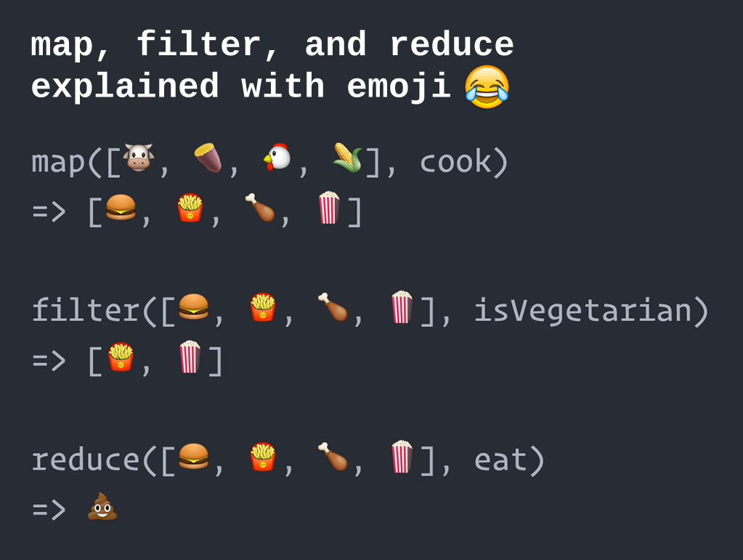
www.globalnerdy.com/2016/06/23/map-filter-and-reduce-explained-using-emoji
Notes:
Found this on the Internet
Funny, yet accurate example of Map Reduce Walk through each step

Slide 10
Stock dataset
Date | Open | High | Low | Close | Volume | Adj Close*
Oct 6, 2015 | 26.99 | 27.41 | 26.96 | 27.29 | 70,409,000 | 27.29
Oct 5, 2015 | 26.37 | 27.20 | 26.22 | 26.82 | 103,735,400 | 26.82
Oct 2, 2015 | 24.87 | 25.49 | 24.83 | 25.47 | 42,508,500 | 25.47
Oct 1, 2015 | 25.15 | 25.31 | 24.79 | 25.19 | 39,649,700 | 25.19
Sep 30, 2015 | 24.73 | 25.24 | 24.69 | 25.22 | 43,496,700 | 25.22
Sep 29, 2015 | 24.33 | 24.60 | 24.26 | 24.57 | 41,155,800 | 24.57
Sep 28, 2015 | 24.69 | 24.74 | 24.31 | 24.31 | 42,431,300 | 24.31
Sep 25, 2015 | 25.00 | 25.04 | 24.86 | 24.92 | 38,818,000 | 24.92
Sep 24, 2015 | 24.87 | 25.45 | 24.65 | 24.91 | 53,239,500 | 24.91
Sep 23, 2015 | 25.01 | 25.33 | 24.98 | 25.14 | 41,190,000 | 25.14
Sep 22, 2015 | 24.76 | 25.16 | 24.60 | 25.11 | 44,205,000 | 25.11
Sep 21, 2015 | 24.89 | 25.20 | 24.84 | 25.09 | 29,618,900 | 25.09
Sep 18, 2015 | 25.15 | 25.21 | 24.71 | 24.80 | 77,869,300 | 24.80
Sep 17, 2015 | 25.50 | 25.93 | 25.27 | 25.35 | 48,844,100 | 25.35
Sep 16, 2015 | 25.53 | 26.03 | 25.42 | 25.93 | 61,540,100 | 25.70
Sep 15, 2015 | 24.90 | 25.45 | 24.70 | 25.30 | 46,334,700 | 25.08
Sep 14, 2015 | 24.97 | 24.98 | 24.60 | 24.77 | 26,237,600 | 24.55
Sep 11, 2015 | 24.74 | 24.96 | 24.50 | 24.95 | 31,903,000 | 24.73
Sep 10, 2015 | 24.56 | 24.86 | 24.50 | 24.68 | 35,043,100 | 24.46
Sep 9, 2015 | 25.20 | 25.22 | 24.48 | 24.55 | 34,611,200 | 24.33
Sep 8, 2015 | 24.51 | 24.98 | 24.27 | 24.96 | 46,212,800 | 24.74
Sep 4, 2015 | 24.18 | 24.18 | 23.85 | 24.00 | 35,628,400 | 23.79
Sep 3, 2015 | 24.76 | 24.95 | 24.39 | 24.51 | 33,564,800 | 24.29
Sep 2, 2015 | 24.14 | 24.58 | 23.83 | 24.57 | 50,480,800 | 24.35
Sep 1, 2015 | 24.24 | 24.36 | 23.68 | 23.88 | 65,344,000 | 23.67
Aug 31, 2015 | 24.98 | 24.98 | 24.58 | 24.82 | 37,006,800 | 24.60
Aug 28, 2015 | 24.92 | 25.17 | 24.78 | 25.16 | 32,942,500 | 24.94
Aug 27, 2015 | 24.43 | 25.01 | 24.38 | 25.01 | 64,894,200 | 24.79
Aug 26, 2015 | 23.85 | 24.07 | 23.27 | 24.01 | 78,965,900 | 23.80
Aug 25, 2015 | 24.73 | 24.74 | 23.27 | 23.27 | 60,778,000 | 2
Month | Average Open | High | Low | Average Close | Total Volume
OCT | 25.845 | 27.41 | 25.19 | 26.19 | 256,302,600
SEP | 24.79333 | 25.06905 | 24.54238 | 24.83429 | 927,769,100
AUG | 24.77667 | 25.05333 | 24.58 | 24.99667 | 134,843,500
Notes:
This example is based on daily stock results Rolled up to provide monthly stats
Notice multiple Reduction functions here. Compare the size of the data before and after
Question: How can we tell which Company had the highest stock value for a month Question: How can we tell which Day had the most activity Answer: We can't because the data has been lost in the reduce

Slide 11
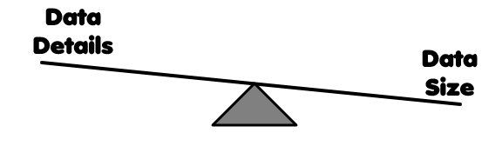
Notes:
This is what makes developing hard and keeps us in business It's important to spend time figuring out What details the customer need Which details get in the way Iteration of datasets is important Architect your data operations for change and growth Architect your data Visuals for change too

Slide 12

Business Requirement Make a Bar Chart
Now that we have all the data separated out …
Your Client wants to see it in a Bar Chart.
Options:
Generate Chart server side and Embed PDF
Plain old HTML and CSS
D3
And more …
Notes:
You get a napkin with your requirements Document drawn on it.
How can we do this?
Switch to Example 1

Slide 13
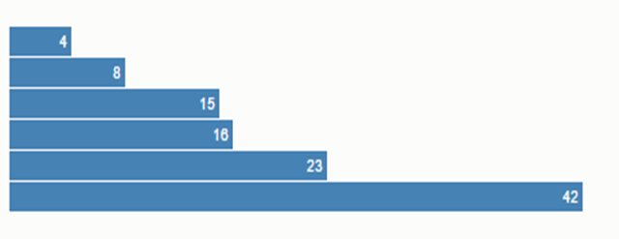
Example 1: HTML and Divs
From:
http://bost.ocks.org/mike/bar/
Functional …
but its BORING!!, inflexible,
manual math, non-interactive.
Notes:
Switch to Example 2
Show redoing this with D3
This shows basic setup
Select – Enter - Exit

Slide 14

D3.js
D3.js is a JavaScript library for manipulating documents based on data. D3 helps you bring data to life using HTML, SVG, and CSS. D3’s emphasis on web standards gives you the full capabilities of modern browsers without tying yourself to a proprietary framework, combining powerful visualization components and a data-driven approach to DOM manipulation.
Written by Mike Bostock
http://d3js.org/
Notes:
D3 works within the DOM Doesn't replace the DOM Similar concepts to jQuery
Mike Bostock started it while working at New York Times
Release in 2011.
Strong Open Source Community.

Slide 15
D3 Gallery
https://github.com/d3/d3/wiki/Gallery
340+ Visual examples
600+ Links to even more examples
Look for a chart you want to create and you
will most likely find a working sample to build from.
Notes:
Here are examples of what D3 can do. Remember I said it was community supported Scroll through the items
Switch to Example 2.1 then 2.2

Slide 16
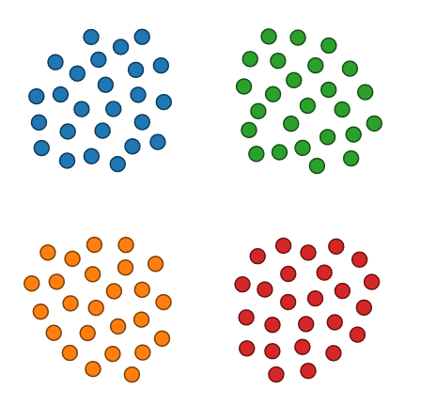
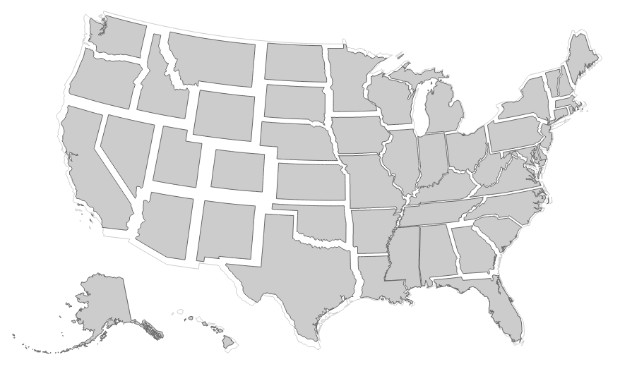
D3 Samples
Force Layout
Carto gram
Notes:
Lets use some of this power in our Bar Chart
Switch to Example 3

Slide 17
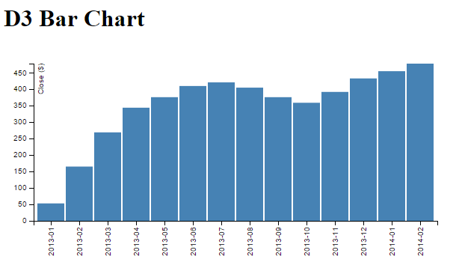
D3.js Data Driven Bar Chart
Now we’re
Talking!!
We need Interaction
Notes:
Code size is starting to grow.
Can we refactor?
DC.js can help. Built on top of D3.js.
Switch to Example 4-DC-Bar-chart.html

Slide 18
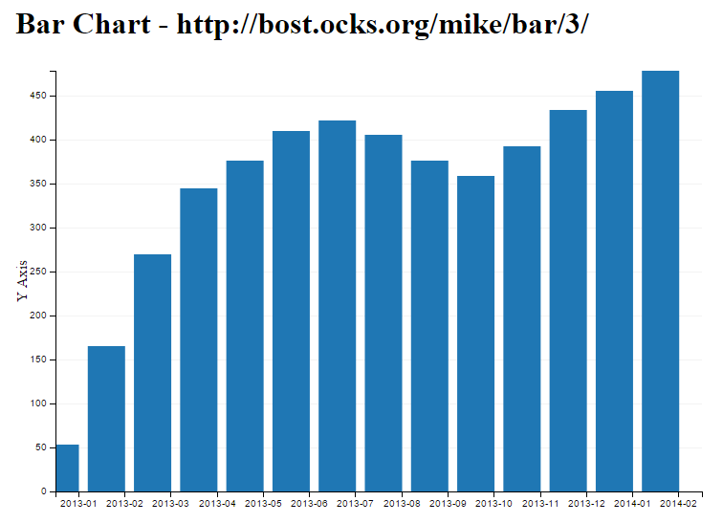
DC BarChart
Notes:
Cool, much fewer lines of code.

Slide 19

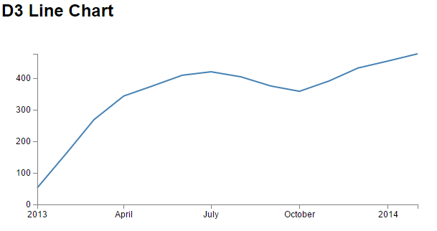
Requirement Change
We want to switch from Bar Chart to Line Chart.
Should be easy right …
These’s gotta
Be a better way
Notes:
Guess what, a new napkin appears …
Switch to 5-D3-Line-chart.html

Slide 20

Clients are happy
But …
Now they want a Dashboard
with more features.
Multiple charts that Interact
with each other.
Notes:
How does interaction happen?
Switch to 6-D3-Dashboard.html
Show amount of CUSTOM code to add each chart.

Slide 21
D3 Dashboard

Slide 22

DC.Js
dc.js - Dimensional Charting Javascript Library
dc.js is a javascript charting library with native crossfilter support and allowing highly efficient exploration on large multi-dimensional dataset (inspired by crossfilter's demo).
It leverages d3 engine to render charts in css friendly svg format. Charts rendered using dc.js are naturally data driven and reactive therefore providing instant feedback on user's interaction. The main objective of this project is to provide an easy yet powerful javascript library which can be utilized to perform data visualization and analysis in browser as well as on mobile device.
https://dc-js.github.io/dc.js/
Fluent interface – Be careful of return type and order.
Great for Dashboards

Slide 23

Cross Filter
Crossfilter is a JavaScript library for exploring large multivariate datasets in the browser. Crossfilter supports extremely fast (<30ms) interaction with coordinated views, even with datasets containing a million or more records; we built it to power analytics for Square Register, allowing merchants to slice and dice their payment history fluidly.
http://square.github.io/crossfilter/
Notes:
Go to the website to show the details.

Slide 24
Cross Filter
A Javascript Map / Reduce framework.
Steps for using Cross Filter
Create Indexes | var ndx = crossfilter(data); var all = ndx.groupAll();
Create Dimensions | var dateDimension = ndx.dimension(function (d) { return d.date; });
Create Groups | var dayWebGroup = dayDimension.group().reduceSum(function (d) { return d.web; });
Use Groups on the charts | stocksChart .dimension(dayDimension) .group(reduceGroup, "TV Spots")

Slide 25
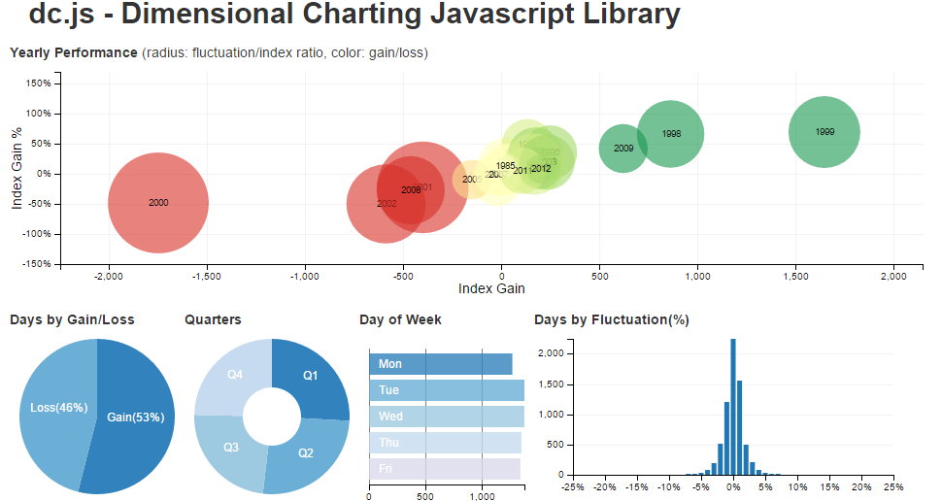
DC Dashboard

Slide 26
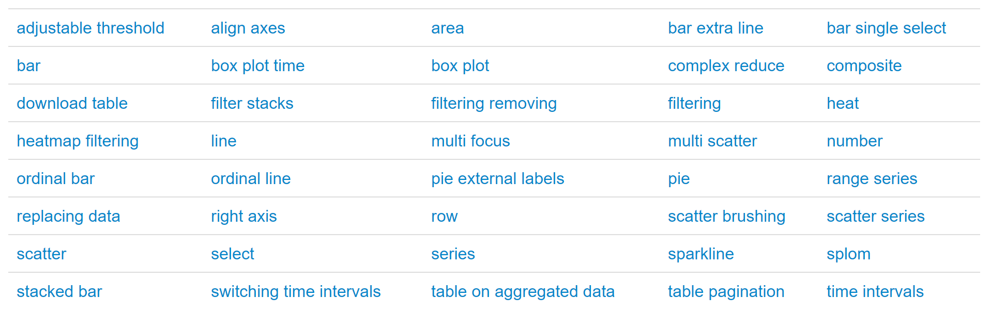
DC Chart Examples [../dc.js/examples]

Slide 27
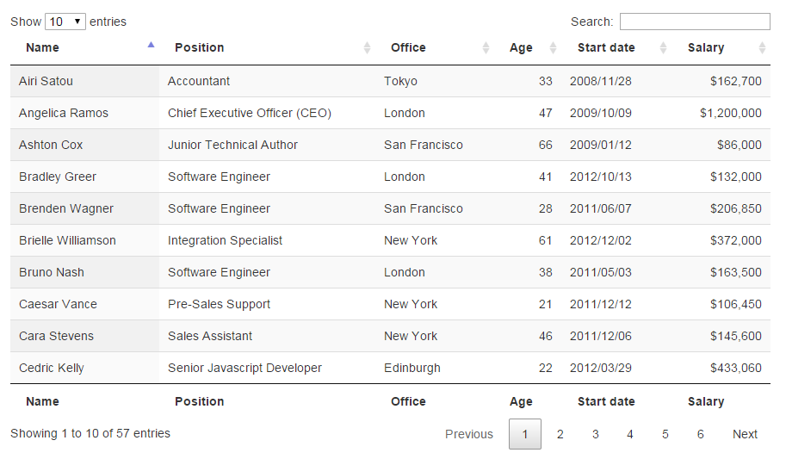
DataTables
DataTables Table plug-in for jQuery
https://datatables.net/
DataTables is a plug-in for the jQuery Javascript library. It is a highly flexible tool, based upon the foundations of progressive enhancement, and will add advanced interaction controls to any HTML table.
Highly configurable JavaScript library for displaying data in tables.

Slide 28
Conclusion
All Open Source – Still cant believe these tools are free.
Easy entry to building Dashboards.
It is still tough, but lots of help available online.

Slide 29
Thanks for Listening
Covered: d3.js dc.js crossfilter.js
moment.js datatables.net
Contact Info: Doug.Mair@gmail.com
@doug_mair
Feel free to ask Questions?

